Slide 1
How to Hire / Purhase JyotishShastra Horoscope Services
Available Online Horoscope Services
‡ Vedic Horoscope Analysis
‡ Red Book Horoscope Analysis
‡ Match Making Horoscope Report
‡ Marriage Horoscope Analysis Report
‡ Love Horoscope Analysis Report
‡ Career / Job Horoscope Report
‡ Shani Sade Sati / Mangal / KaalSarp
Dosh Analysis Horoscope Report
‡ Health / Education /Wealth Horoscope
‡ Vastu Consultancy Services
‡ Palmistry Horoscope Report
‡ GemStone Suggestions
www.JyotishShastra.com

Slide 2
Selection of Horoscope Service & Utiliazition of Discount Coupon
Type www.JyotishShastra.com on your web browser. Website will Open.
Select a Horoscope Service from the list located at Left side of desktop under the Tab
[ JS Horoscope Services ]
Here to make you understand we have selected third number horoscope service
[ Love Horoscope Analysis ]
Now you will be redirected to related horoscope service page with link :
www.jyotishshastra.com/horoscope/service/love-horoscope-analysis
Now Scroll this web page down,
www.JyotishShastra.com

Slide 3
Selection of Horoscope Service & Utiliazition of Discount Coupon
Now Scroll this web page down.
Here you will get a Discount Coupon Code written with Green Color, as example
[ LOVE28 ]
Type this coupon code in the “Apply discount coupon” box and Click on “Apply” Tab.
By this you will get direct discount on service price as applicable on related service.
www.JyotishShastra.com

Slide 4
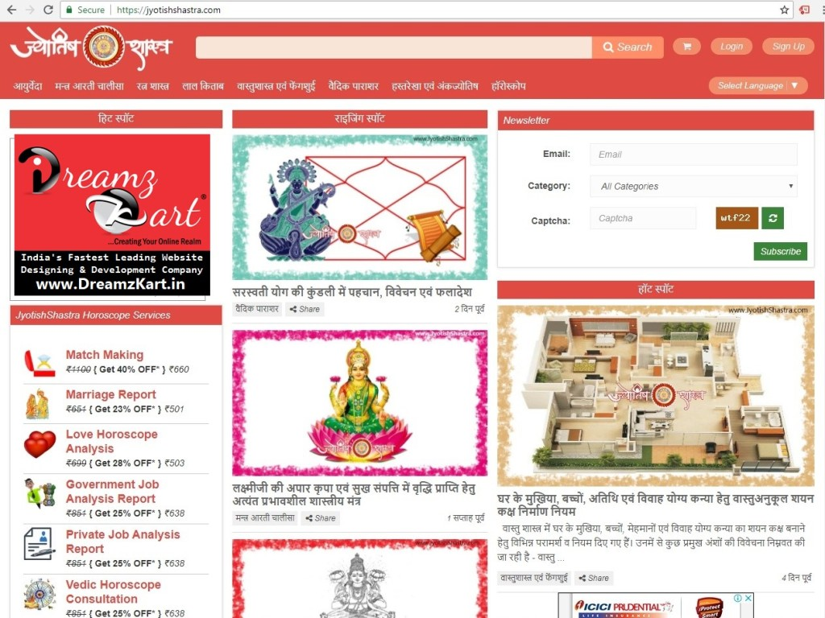

Slide 5
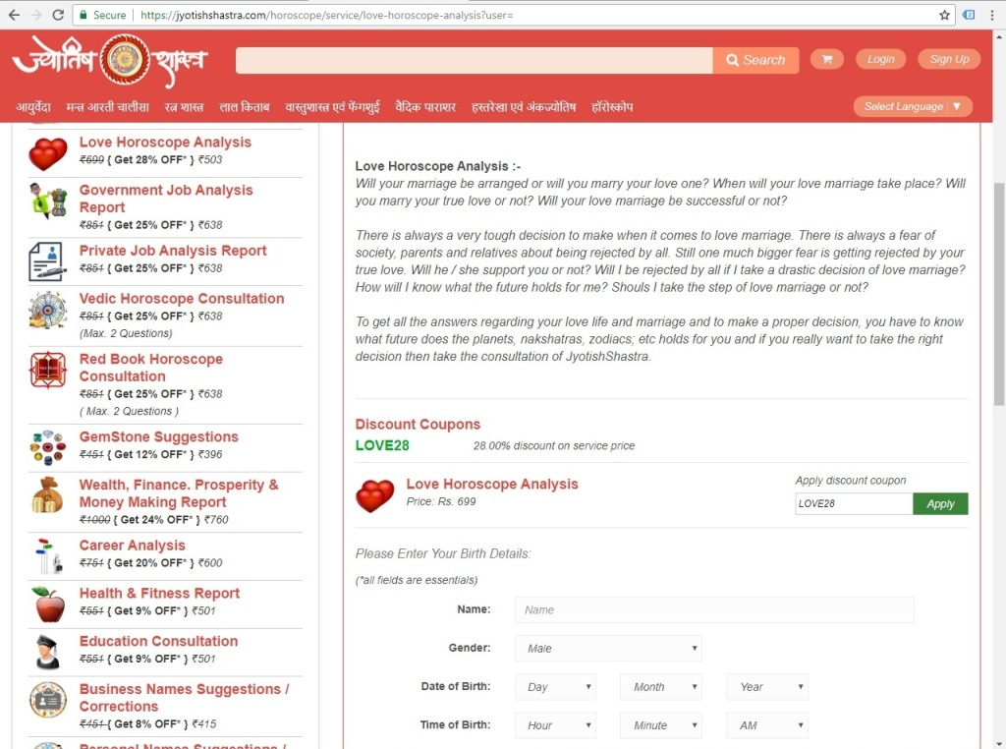

Slide 6
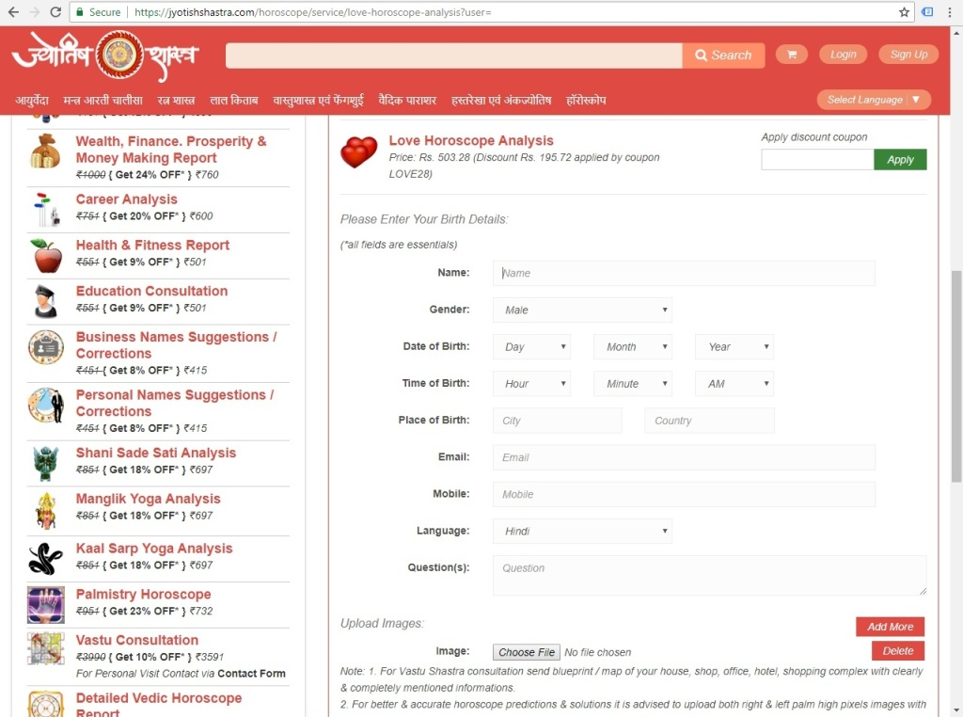

Slide 7
Filling up the Horoscope Form & Uploading Palm Images or Scans
Now Scroll this web page down, you will see a Horoscope Form.
Fill up this form with correct & complete details as asked.
Upload your Left & Right both hands Palm Images / Scans. Via Upload Images.
Click on “Choose a file” tab, upload image from your device / click from camera and upload image. Click on Add More tab of Red color and add more images.
If you have added wrong Image file click on Delete Tab, and then Click on Add More tab to upload new Image or Scan.
Note :- You can upload and submit maximum 6 images of maximum 4mb each at a time. Only
Png, Jpg, Jpeg, Gif format allowed.
www.JyotishShastra.com

Slide 8
Submission of Horoscope Form & Adding Service details to My Cart
Enter Captcha Code in the given box to validate yourself, that you are a human not a robot.
Click on Box and place a Check Mark in Box for the acceptation of Terms Conditions & Policies.
Click on “Submit” tab, to submit your details.
Now your selected horoscope service has been added to Cart. You may see it on next redirected page or also by clicking on “Cart” icon located in header section at the Top Right side corner of Webpage.
www.JyotishShastra.com

Slide 10
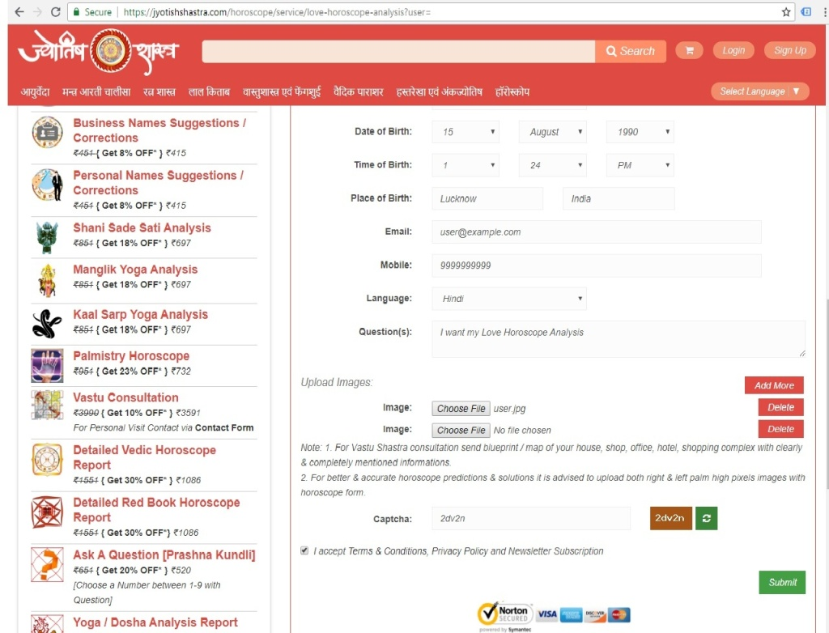

Slide 11
Placing Order & Editing / Deleting of Cart
Click on “Edit Details” Only if you want to Edit your horoscope form details.
Click on “Remove” Only if you want to Delete your Cart.
Click on “Continue Horoscope” Only if you want to add another New Horoscope Service.
Else
Click on “Place Order” tab, to convert your Cart into Order.
A Login / SignUp PopUp will open.
If you already have an account with JyotishShastra then “Login” your account OR if you are a new user and yet not have your account with JyotishShastra then go for “SignUp” process.
www.JyotishShastra.com

Slide 12
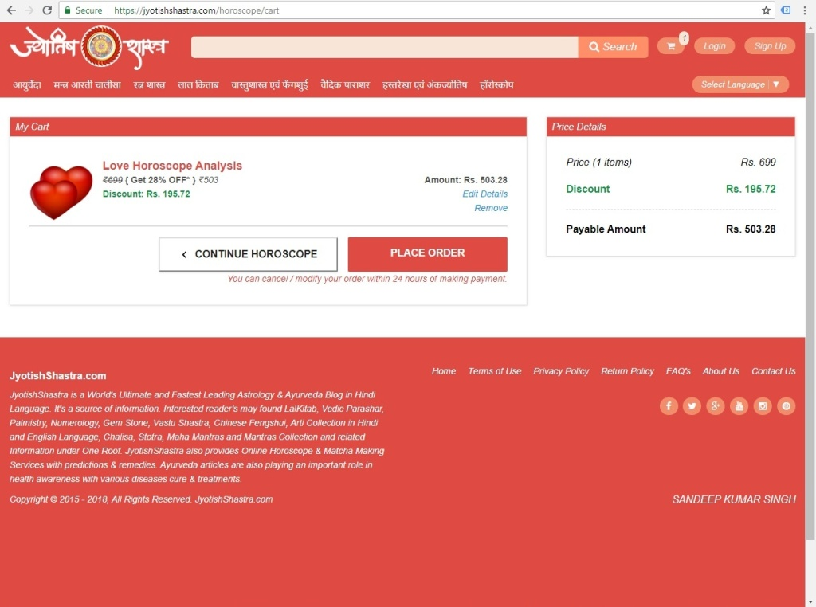

Slide 13
Process to Fill & Submit SignUp Form
Click on “Signup” located at the bottom of popup page. SignUp Form page will open.
Fill all required details correctly in the Form :-
*Full Name : ( Will be your User name too )
*Email Id : ( Used for Account Verification & Information with Horoscope Report Download Link)
*Mobile Number : ( Used for User verification and also used in Account Login to receive OTP in case forget password or to login without login credentials )
*Password : ( your new password to login your JyotishShastra account after SignUp )
*Captcha Code : ( To validate that you are a human not a robot )
Click on “SignUp” tab.
www.JyotishShastra.com

Slide 14
Process to Validate Mobile Number to Complete SignUp Process
A new popup windo open with message “RegistrationSuccessful, Please verify your email by clicking on verification link sent on your email”
Also asked to Verify Your Mobile Number.
Here you will receive a system generated 6 digit OTP Code on your mobile number for User’s verification.
If not received OTP, then Click on Resend OTP & wait for few seconds.
As soon as you received 6 digit OTP on your mobile number.
Type this 6 digit OTP Code in the box to verify your mobile. Your Mobile Number is now verified.
www.JyotishShastra.com

Slide 15
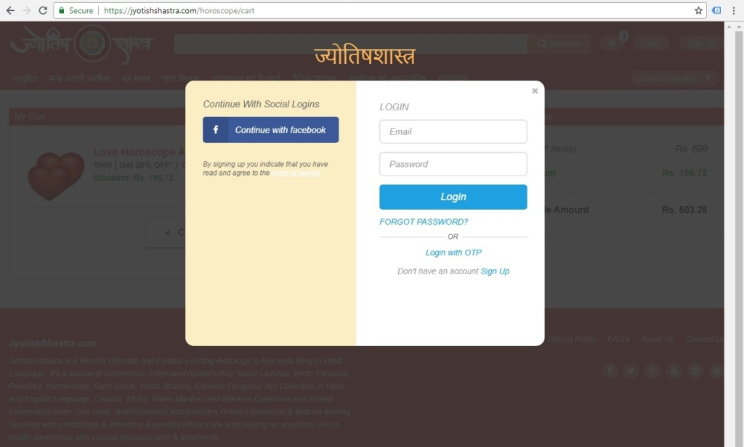

Slide 16
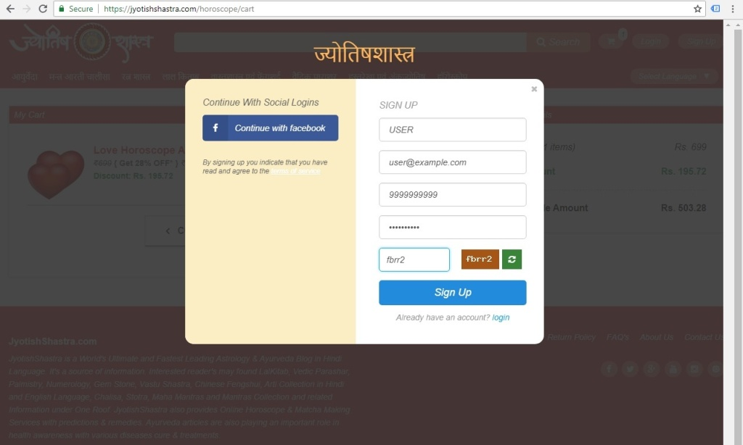

Slide 17
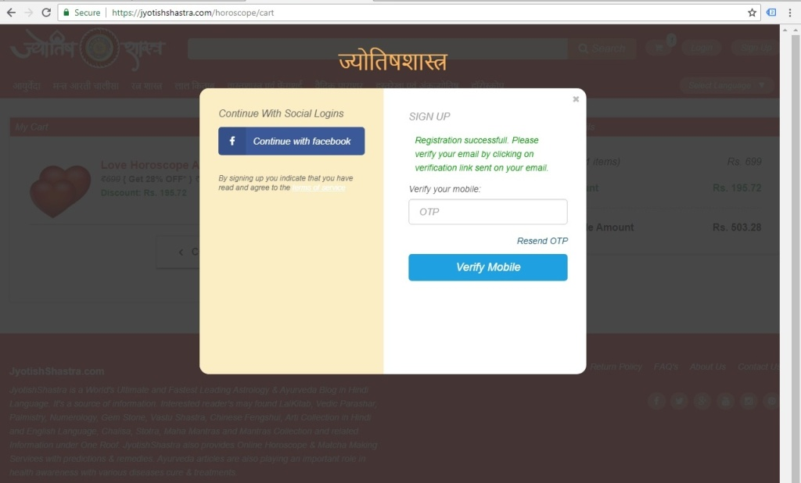

Slide 19
Process to Validate Email ID to Complete SignUp Process
…………..In the same process
As you click on “SignUp” tab, you will receive a system generated verification email on your given email id.
Open / Login your email id and check for new received email with name “JyotishShastra”
If not found, Wait for 1-2 minutes, let server to respond, Refresh / Reload your email id, If then also this email is not found in Inbox then check in Spam / Junk box of your email id.
If received in Spam / Junk box, don’t worry, Open Email and Click on Not Spam / Not Junk email.
www.JyotishShastra.com

Slide 20
Process to Validate Email ID to Complete SignUp Process
…………..In the same process
By Clicking on Green Color “Activate Account” Tab available on account activation email, you will automatically redirected to “My Cart” webpage.
It means that Your www.JyotishShastra.com Account SignUp Process is completed and your Account is now Activatedfor further procedures.
www.JyotishShastra.com

Slide 21
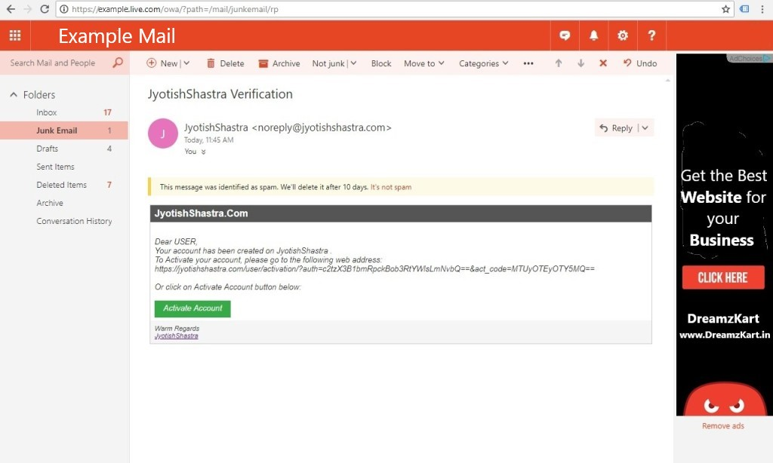

Slide 22
Process of Making Payment for the Completion of Order
Click on “Proceed Order” tab on My Cart Page.
The system will redirect you to Payment Gateway page for making payments.
From here you can make payment by using Debit Card / Credit Card / Online Bank Transfer / Digital Wallets & etc. payments methods.
Choose the appropriate payment procedure by which you want to make payment.
Complete the payment process.
www.JyotishShastra.com

Slide 23
Process of Making Payment for the Completion of Order
As payment process completes, system will redirect to “Payment Successful” Order page of website.
User will receive an Order Confirmation email on its email id too.
Here User can see Order details. User can also see Order details after words by login its JyotishShastra Account.
www.JyotishShastra.com

Slide 24
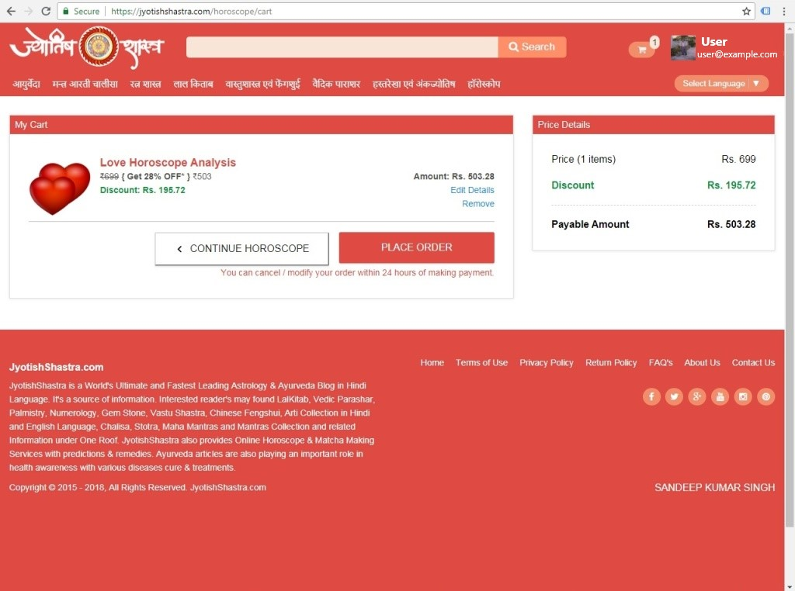

Slide 25
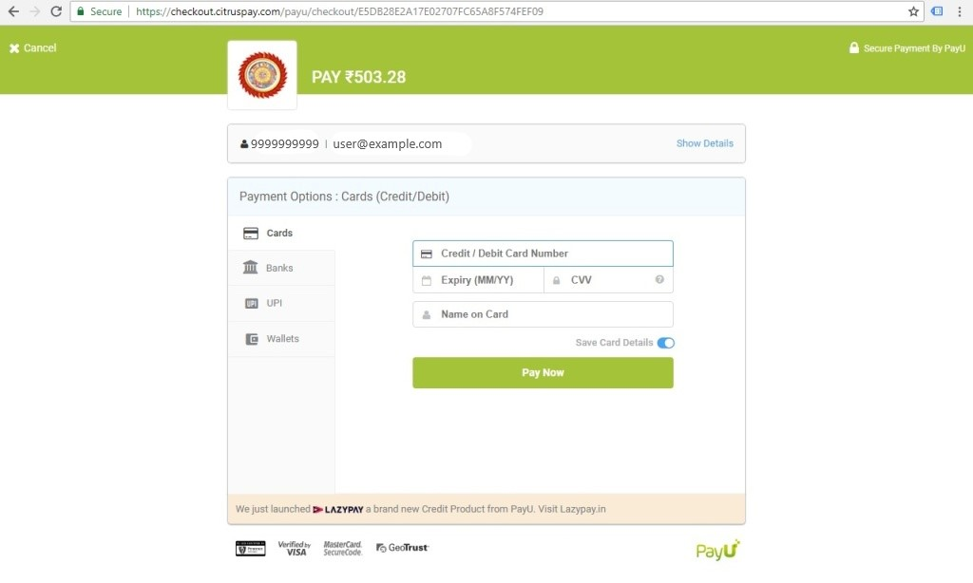

Slide 26
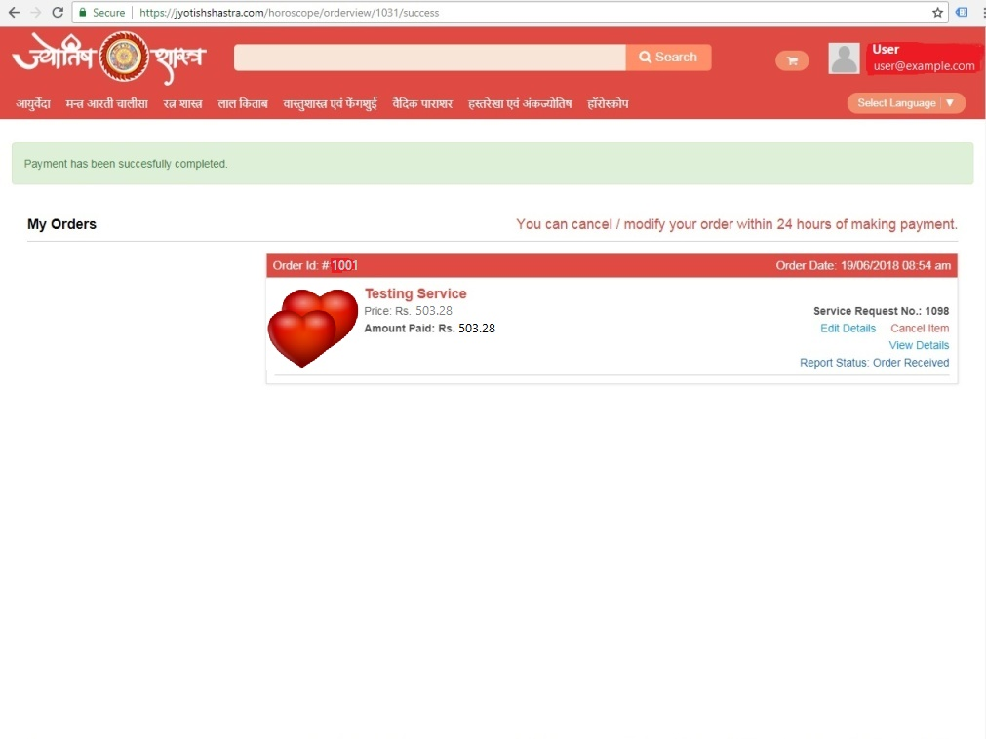

Slide 27
Process to Watch / Cancell Order Details & Download Horoscope Report from Account
To Watch Order Details an User must have to Login JyotishShastra Account.
Go to Top of the Right Side Corner of webpage.
There You can see User Image, User Name & Email id.
Click on User’s Name.
Click on My Order.
From My Order page User can Cancel Order within 24 hours of making payment.
After 24 hours, Order will be Processed. User can Check Order Status from this page.
www.JyotishShastra.com

Slide 28
Process to Watch / Cancell Order Details & Download Horoscope Report from Account
Order when processed then “Order Received” Status of Order will be changed to “Processed”.
User can download Ordered Horoscope Report from “My Order” page once Uploaded by Admin to Users JyotishShastra Account & after Report Status changed to “View Order”.
www.JyotishShastra.com

Slide 29
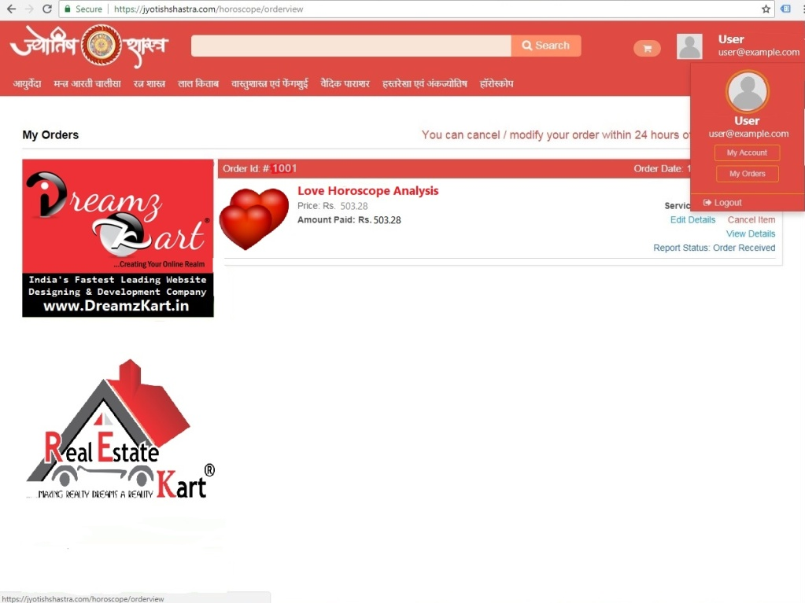

Slide 30
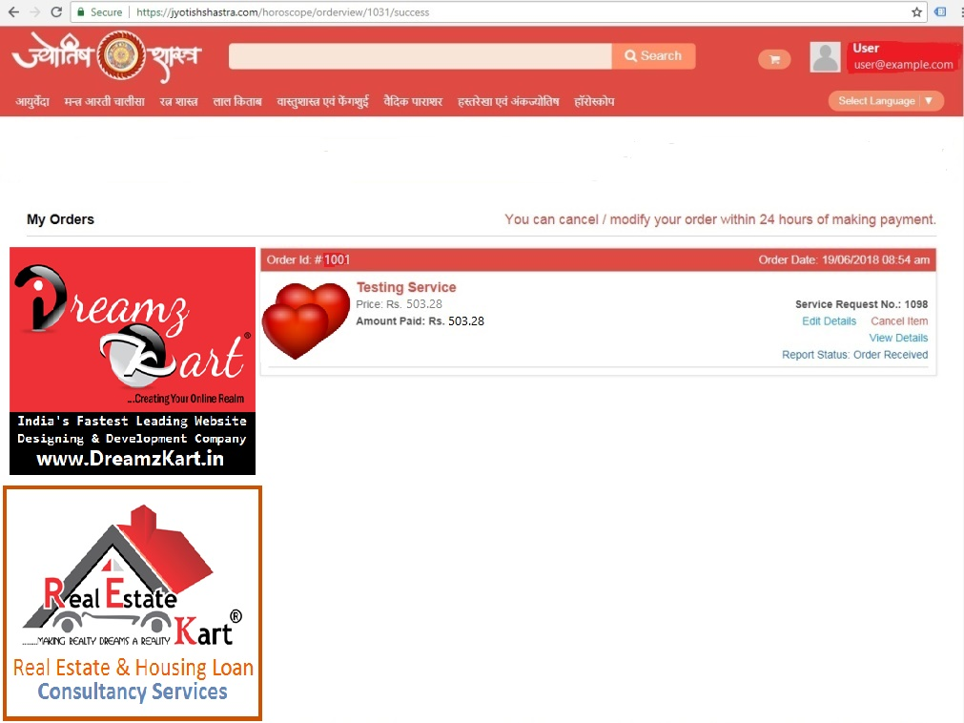
Horoscope Form Details
Order Status

Slide 31
Click & Download Horoscope Report

Slide 32
Contact Details Of JyotishShastra
Contact Details :
Website :- https://JyotishShastra.com
Online Horoscope Services :- https://JyotishShastra.com/horoscope
Email :- care@jyotishshastra.com
Website Contact Form :- https://JyotishShastra.com/contactus
Brain Behind JyotishShastra :
Gurudev Sandeep Pulastya
# Jyotish Visharad
# Vastu Visharad
# Astrology Blogger
www.JyotishShastra.com

